Slide 1
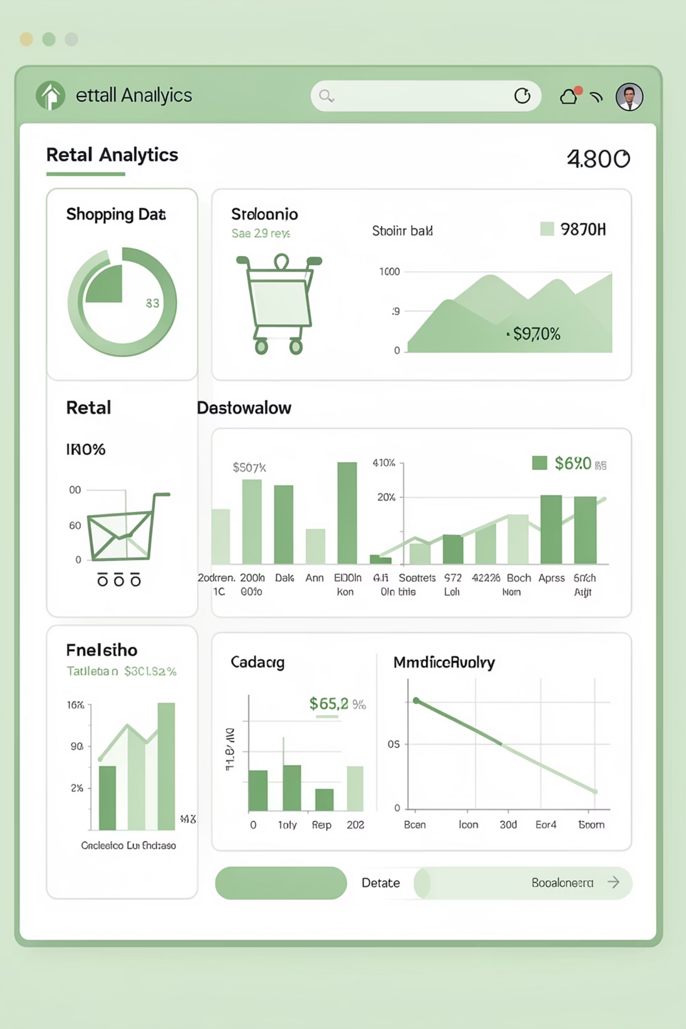
Customer Shopping Behavior Analysis
Analyzing 3,900 purchases to uncover spending patterns, customer segments, and product preferences that drive strategic business decisions.

Slide 2

DATASET
Dataset Overview
3,900
18
37
Total Purchases
Data Features
Missing Values
Transactions analyzed
Columns tracked
In review ratings only
Key features include customer demographics (age, gender, location), purchase details (category, amount, season), and shopping behavior (discounts, reviews, shipping type).

Slide 3

Data Preparation in Python
01
Data Loading & Exploration
Imported dataset using pandas, checked structure with df.info() and summary statistics
02
Data Cleaning
Imputed missing review ratings using median by category, standardized column names
03
Feature Engineering
Created age groups and purchase frequency metrics, removed redundant columns
04
Database Integration
Connected to PostgreSQL and loaded cleaned data for SQL analysis

Slide 4

SQL ANALYSIS
Key Business Insights
Performed structured analysis in PostgreSQL to answer critical business questions:
Revenue comparison by gender
High-spending discount users
Top-rated products
Shipping type preferences
Subscriber vs. non-subscriber behavior
Customer segmentation patterns

Slide 5
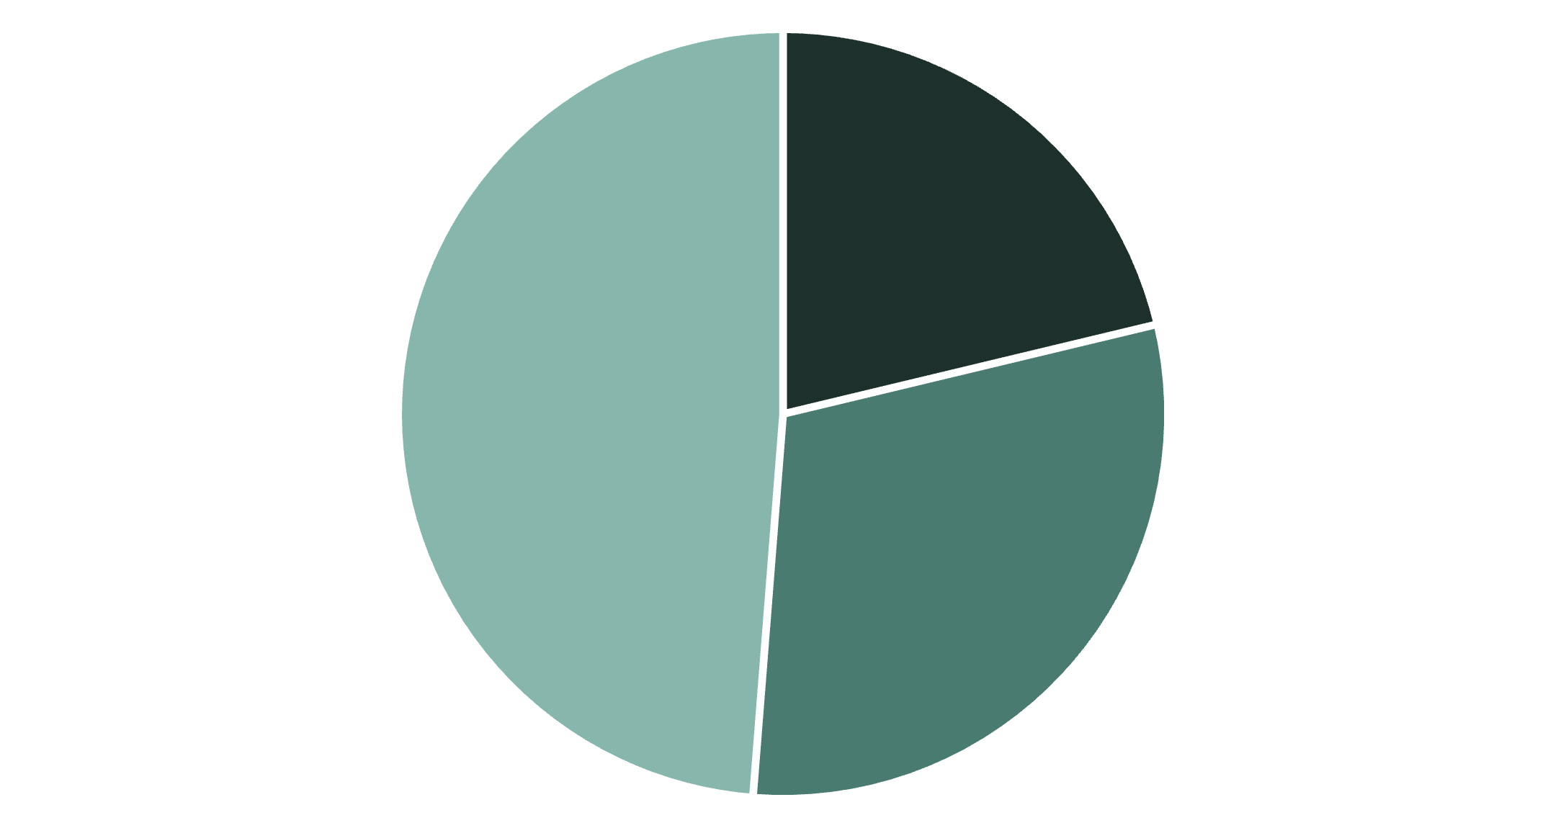
Revenue & Customer Segments
Customer Classification
Customers segmented into New, Returning, and Loyal based on purchase history. Loyal customers drive the highest revenue contribution.
Repeat buyers with 5+ purchases show significantly higher subscription rates, indicating strong correlation between purchase frequency and subscription likelihood.
New
Returning
Loyal

Slide 6

Subscription Impact
Subscribers
Non-Subscribers
Higher average spend per transaction and greater lifetime value
Lower average spend but represent growth opportunity
Subscribers consistently outspend non-subscribers across all product categories. Express shipping users show 23% higher average purchase amounts compared to standard shipping customers.

Slide 7
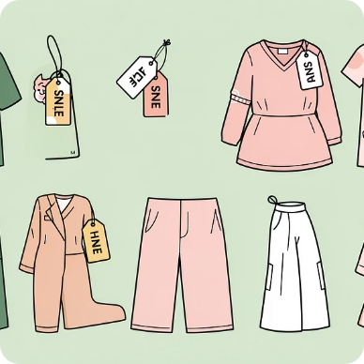


Discount & Product Performance
Discount-Dependent Products
Top-Rated Items
High-Value Buyers
Highest-rated products maintain strong sales without heavy discounting
Customers using discounts but spending above average represent strategic segment
Five products show 70%+ discounted purchase rates, indicating price sensitivity

Slide 8
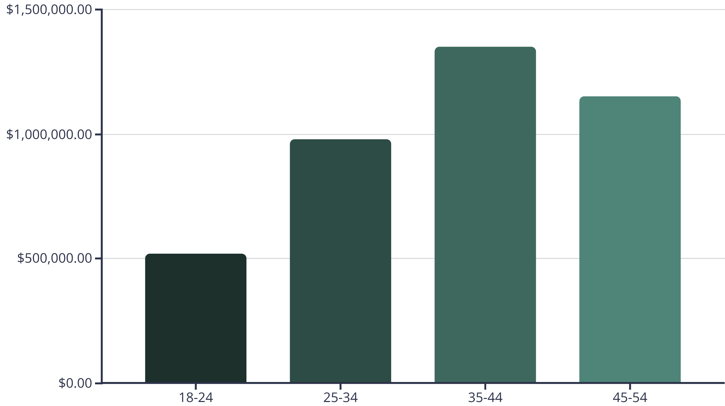
Age Group Revenue Distribution
Key Findings
Revenue contribution varies significantly across age groups, with middle-aged customers (35-54) driving the highest total revenue.
Younger demographics show higher engagement with promotional codes and express shipping options.

Slide 9
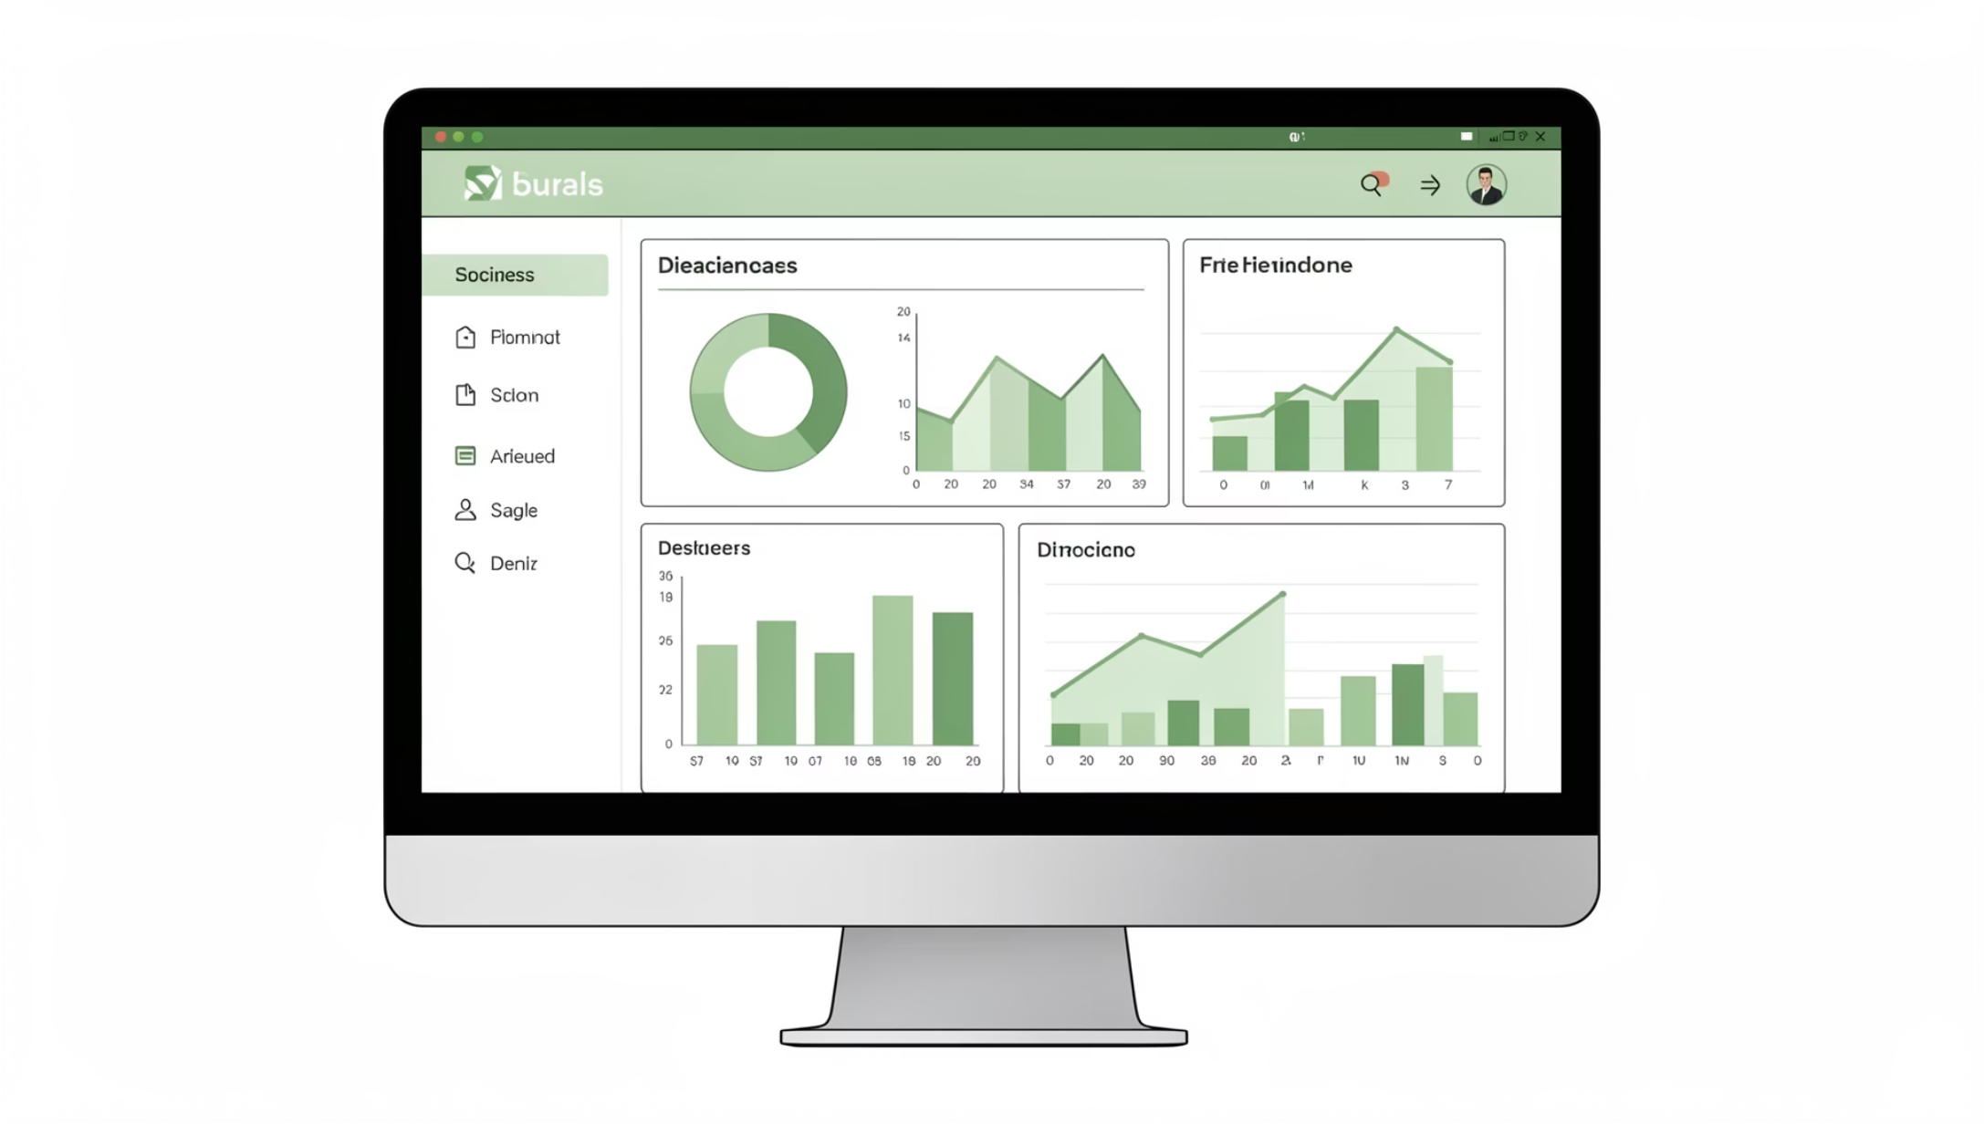
VISUALIZATION
Interactive Power BI Dashboard
Visual Analytics
Built comprehensive dashboard presenting all insights through interactive visualizations.
Enables real-time exploration of customer segments, product performance, and revenue trends across demographics.

Slide 10
Strategic Recommendations
Boost Subscriptions
Loyalty Programs
Optimize Discounts
Product Positioning
Reward repeat buyers to accelerate movement into loyal customer segment
Balance promotional sales with margin control to protect profitability
Highlight top-rated and best-selling products in marketing campaigns
Promote exclusive benefits to convert high-frequency buyers into subscribers
Targeted Marketing
Focus on high-revenue age groups and express-shipping preference customers

